Slide 1
LSTM 200 BLOCK
LSTM 1 BLOCK
DU TO ROBERT/皇旗

Slide 2
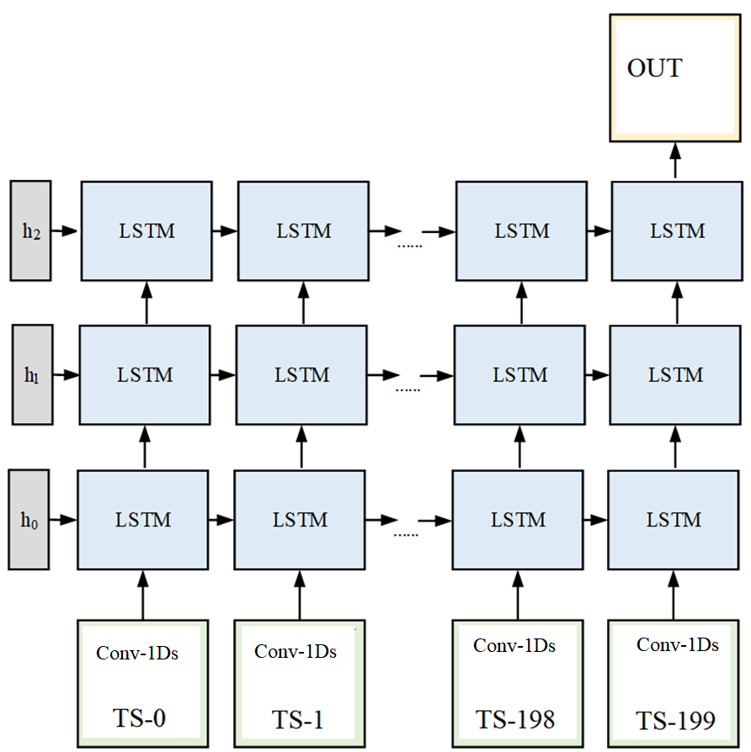
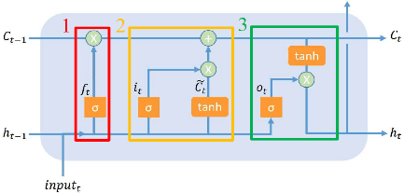

Slide 3

LSTM 1 BLOCK

